Slide 1
Viruses

Slide 2
Outline
Introduction
General properties of viruses
Structure of viruses
Replication of Virus

Slide 3
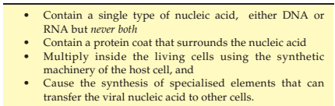
Nature and classification of virus
Virus which in Latin means poison
Viruses are obligate intracellular parasites
Replicate (or multiply) only inside a living host cell.
These have very simple structural organization but are characterized by certain distinctive features
Table 1. Distinctive features of viruses

Slide 4
General properties of viruses
All forms of life —animal, plant and even bacterial —are susceptible to infection by viruses (Host range).
satellite viruses which depend upon other viruses for their survival and replication.
Polioviruses: only infect human
Rabies virus: attacks cells of CNS of human and variety of warm-blooded animals

Slide 5
Cont.
The specificity of a virus refers to specific kinds of cells virus can infect.
Virus specificity: A virus can attach to a cell or not.
This depends upon the presence of specific receptors on the surface of the virus

Slide 6
Cont.
Three main properties distinguish viruses from their various host cells:
Size,
Nucleic acid content and
Metabolic capabilities

Slide 7
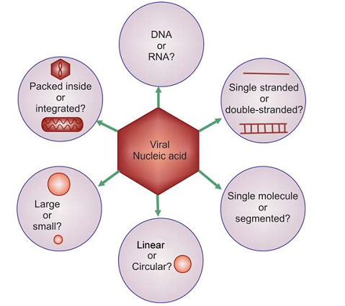
Classification of Viruses
Based on Physicochemical Criteria
a. Kind of nucleic acid and strategy of viral replication b. Morphology of virion which includes size, shape, symmetry of nucleocapsid and presence of envelope.
RNA viruses : ss or ds
All DNA viruses are ds except parvoviruses which are ss
Influenza and reoviruses: segmented.

Slide 8
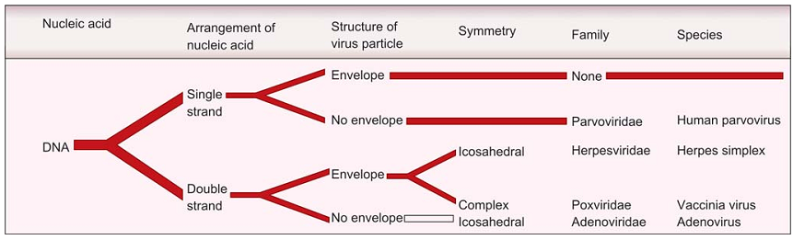
Nomenclature of Viruses
Decided by International Committee on Taxonomy of Viruses.
The viruses are grouped in to
Families: a suffix-viridae.
Subfamilies: suffix-virinae
Genera : suffix of –virus
prefix may be another latin word or a sigla,
Fig. 56–1. Parameters used to classify viruses
Notes:
ICTV

Slide 9
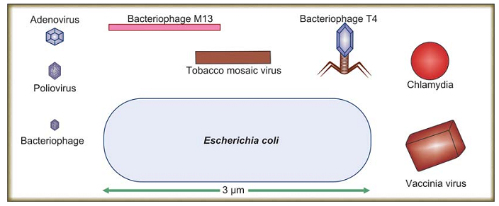
Size of Viruses
The viruses are measured in units of nanometer
Viruses vary in diameter from 3 to 20 nm.

Slide 10
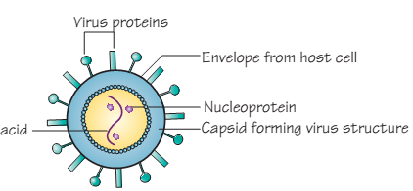
Viruses Morphology
composed of nucleic acids and proteins.
Genome consists of single NA : stores all vital information
Genome surrounded by a shell /coat made of protein: capsid
Genome and capsid : nucleocapsid
An additional covering of lipid around nucleocapsid: envelope
Complete virus particle: Virion
Virion : virus is infectious as well as structurally intact.
Nucleic acid
Notes:
Nucleic acid

Slide 11
Viral Nucleic Acids: DNA/RNA
Capsids: aggregates of repeating subunits arranged in a defined pattern.
The subunits are called as capsomeres.
The capsid has two functions:
To protect genome from external harmful factors
To introduce viral genome into host cells.
Similar functions are also performed by lipid envelope of virus.

Slide 12
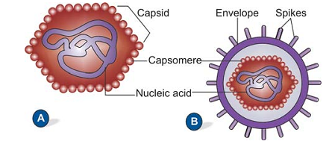
Envelope
In some viruses capsid is covered by a lipid envelope/proteins
Depending on virus, envelopes may be covered by spikes
Haemagglutination: clump red blood cells by influenza virus
Viruses whose capsid is not covered by an envelope: naked
Fig. 2. Naked virus (A) and enveloped virus with spikes (B)

Slide 13
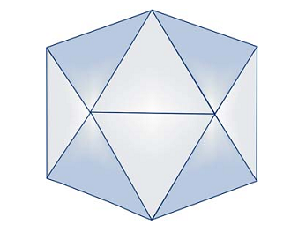
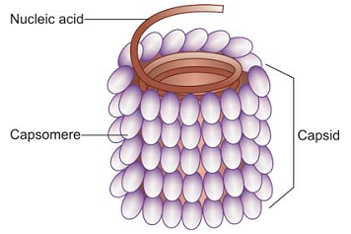
Symmetry of Viruses- capsids
Two types of symmetries
Helical: 10-20 nm in diameter resemble long rods that may be rigid or flexible.
Icosahedral (or cubic or polyhedral): 12 vertices, and 20 faces each an equilateral triangle.
Capsomers arranged : 5:3:2- fold
Fig. 4. Morphology of helical virus
TMV and Rabies virus
Fig. 3. An icosahedron

Slide 14
Complex Viruses
Some viruses have a very complicated structure
E.g. Poxviruses, which don’t contain identifiable capsids with several coats around the nucleic acid.
Viral Proteins two groups: a. Structural proteins: present in coat of virus b. Non-structural proteins (functional proteins): enzymes and haemagglutinins

Slide 15
Four groups of enzymes have been detected in viruses: a. Neuraminidase b. RNA polymerase c. Reverse transcriptase d. Enzymes of cellular origin

Slide 16
Two classes of infectious agents exist
Structurally simpler than viruses.
Viroids: infectious circular RNA molecules lack protein shells
Responsible for a variety of plant diseases.
Hepatitis delta found in association with HBV
II. Prions: lack any genes and composed only of protein
Responsible for some transmissible and inherited spongiform encephalopathies such as
scrapie in sheep; bovine spongiform encephalopathy in cattle; and kuru, Creutzfeldt-Jakob disease, and Gerstmann-Sträussler-Scheinker syndrome in humans.

Slide 17
All viruses follow a similar set of steps to generate new viruses.
The basic steps for replicating virus include: 1. Recognition and attachment 2. Entry into cell 3. Uncoating 4. Synthesis of macromolecular components (genome and structural parts of virion particle) 5. Assembly of new virion particles 6. Exit from the cell

Slide 18
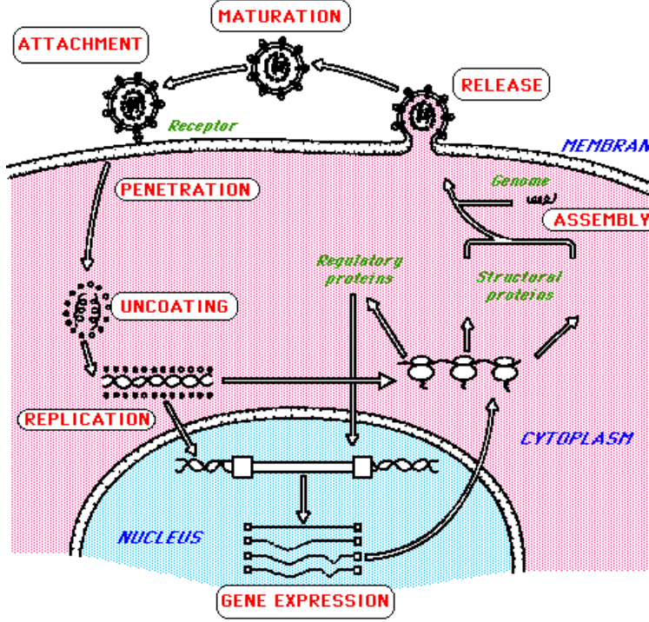
Figure: The basic steps for replicating the virus

Slide 19
1. Recognition, attachment, and entry
Finding and binding of virus to appropriate cell is mediated by:
Surface structures of naked capsid virus or
Glycoproteins of the envelope virus.
Neutralizing antibodies are often specific for attachment proteins

Slide 20
Cont.
Viral attachment proteins (VAP)
keys interact with cell surface receptors and
open doors of entry into the cell.
Adsorption involves VAP and cell surface receptor proteins.
There are 10⁴ to 10⁵ receptors on cell surface.
Bacteriophages : pili
Animal viruses : glycoproteins (plasma membrane )

Slide 21
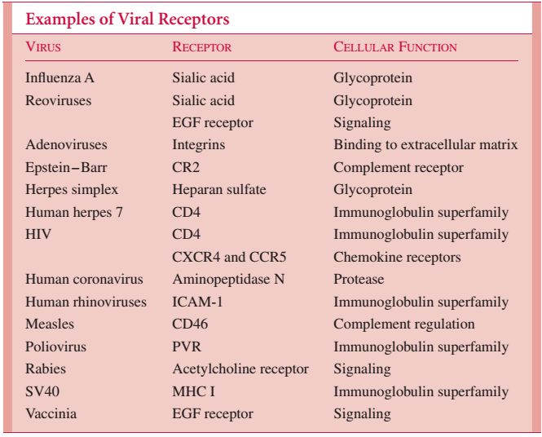
Abbreviations: EGF, endothelial growth factor; HIV, human immunodeficiency virus; ICAM, intercellular adhesion molecule; MHC, major histocompatibility complex; PVR, poliovirus receptor

Slide 22
Uncoating
Uncoating follows, which involves the enzymatic removal of viral protein coat and liberation of nucleic acid and attached core proteins;

Slide 23
Production of virus-specific mRNA
In order to direct host cell ribosome to produce viral proteins (core, capsid).
The mechanisms for virus-specific mRNA production depend on the viral genome type: (a) RNA or DNA; (b) single or double stranded; (c) positive sense or negative sense

Slide 24
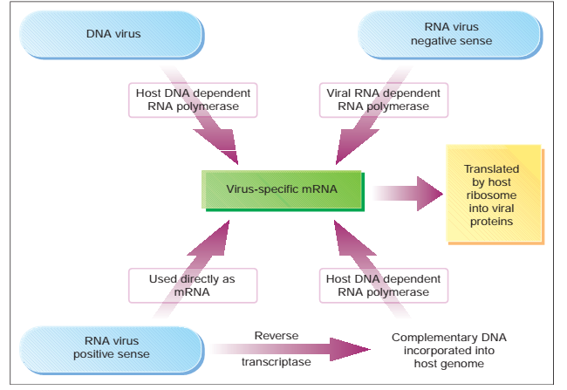
Figure. Synthesis of virus-specific mRNA.

Slide 25
Assembly
Morphogenesis and maturation occur with assembly of components (nucleic acid and proteins) to form
sub-viral particles (pre-core, core particles) and viral particles (virions, empty particles)

Slide 26
Release
Release of virus is by
Bursting of infected cells (lysis): Cell death or
Budding through the plasma membrane: does not necessarily kill cells, allowing viral particles to be shed for extended periods,

Slide 27
Cont.
Most RNA viruses
Replicate using an RNA-dependent RNA polymerase.
Retroviruses and HBV utilize both RNA and DNA in their replication.
Retroviral RNA is copied to DNA by virion reverse transcriptase; host RNA polymerase transcribes DNA into more RNA.

Slide 28
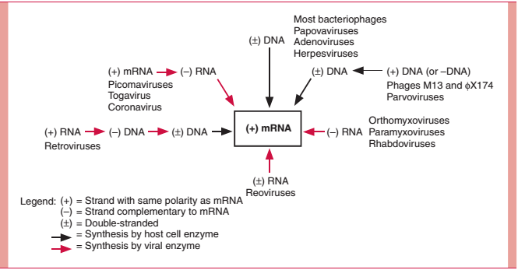
There are a variety of pathways for synthesis of mRNA by different virus groups
Fig. Pathways of mRNA synthesis for major virus groups.

Slide 29
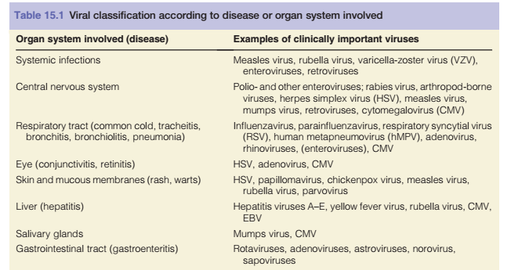

Slide 30
Cont.
Some viruses (e.g., herpes simplex virus) can move between cells (intercellular spaces) to infect neighboring cells without exposing themselves to antibody detection.
Other viruses (HSV, varicella zoster, measles and other paramyxoviruses, and HIV) recruit large numbers of cells into their factory by fusing them together into multinucleated giant cells (syncytia).
Syncytia formation is also a diagnostic characteristic of these viruses.

Slide 31
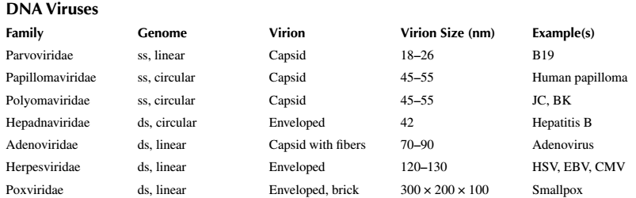
Medical important Virus

Slide 32
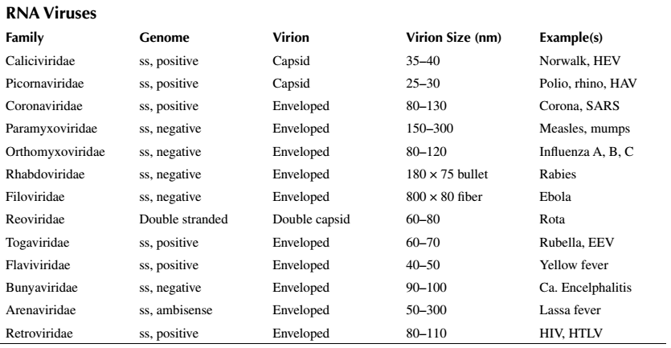

Slide 33
DIAGNOSIS OF VIRAL INFECTIONS
Direct Examination of Clinical Material: -Microscopy and Stains (HSV, VZV, Rabies)
Recruit large numbers of cells into their factory by fusing them together into multinucleated giant cells (syncytia).
Syncytia formation is also a diagnostic characteristic of these viruses (HSV)
Antibody tests
Virus isolation,
Antigen detection or
NAAT (PCR)

